Slide 1
DATA HANDLING
AND VISUALISATION Project Proposal

Slide 2

IN THIS DOCUMENT
01
02
03
About the project
Olympics Data stats and Visualisation.
Major requirements
Data handling tools and visualisation tools.
Project goals
Learning and implementation of handling data.

Slide 3
ACKNOWLEDGEMENT
We want to express our gratitude to Mrs. Gargi Srivastava mam for giving us a chance to implement our data handling knowledge to a great project.

Slide 4
01
About the project

Slide 5
WHAT WE ARE WORKING ON
Project Inside
We are going to show olympics stats of different countries on different sortings. After completion of this project we are able to showcase our knowledge of data preparation, its analysis and its visual representation.

Slide 6
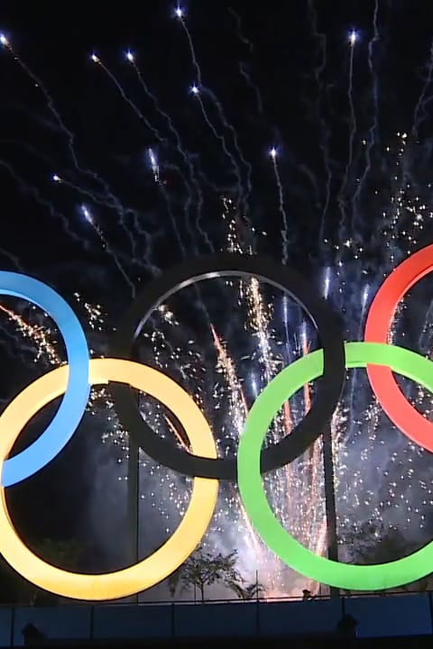
ABOUT THE PROJECT
We are going to show all the statistics of olympics which include all the teams that takes part in the olympics each year(with decided timeline). We will also show each stat with visual representation.

Slide 7

PROJECT ARCHITECTURE
Data preparation
Data Handling
EDA
Data Cleaning
Representation
Visualisation

Slide 8

NOW
We will show each year stats of each country performance in olympics.
Also we will represent each country individual data of how many medals they got and in which sport.
In addition, each sports individual data cal also be smoothly taken from this project.

Slide 9

And that too with visual representation of every set of sorted data.

Slide 10
AIM:
So our main aim is to learn the techniques of data handling and implement it to some real world problems.
Feeding | We will feed our data from different internet source and then integrate it to our set of data.
Methodology | Methods are data preparation, EDA, cleaning, answering queries and representation.
Goals & KPIs | Goal is to implement our knowledge.

Slide 11
PROJECT GOALS
Goal 1
Goal 2
To show all stats of olympics and implement our knowledge to it.
To learn different tools used in our project.

Slide 12
02
Major requirements
Tools used in our project

Slide 13
MAJOR REQUIREMENTS
Microsoft Excel
Python
PowerBI and Matlab
We enter our data from this tool to perform different operations.
This tool is used to perform different types of sorting and coding.
These tool show different visual representation of different stats.

Slide 14
Week 2 Update

Slide 15
What we did
1
2
3
We had solved our issue of duplicacy by using the drop_duplicate commnad
We then analyze our data on various parameter such as maximum participation, Female and male participation and age wise distribution
We plotted graphs from those analyzed parameters and drawn some conclusion

Slide 16
Important
We dropped our idea of not taking the data of less than Year 1960.
We thought we can analyze that data also. So, we are now taking the whole data from 1896 to 2020 Summer Olympics.

Slide 17
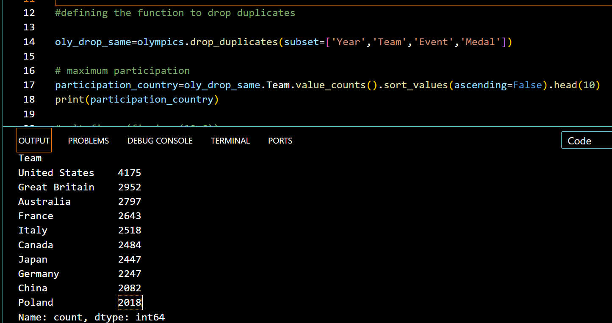
Maximum participation by country
We used the value_counts() function of pandas library to count the participantion of each country and then used the sort_values() to sort them in ascending order.

Slide 18
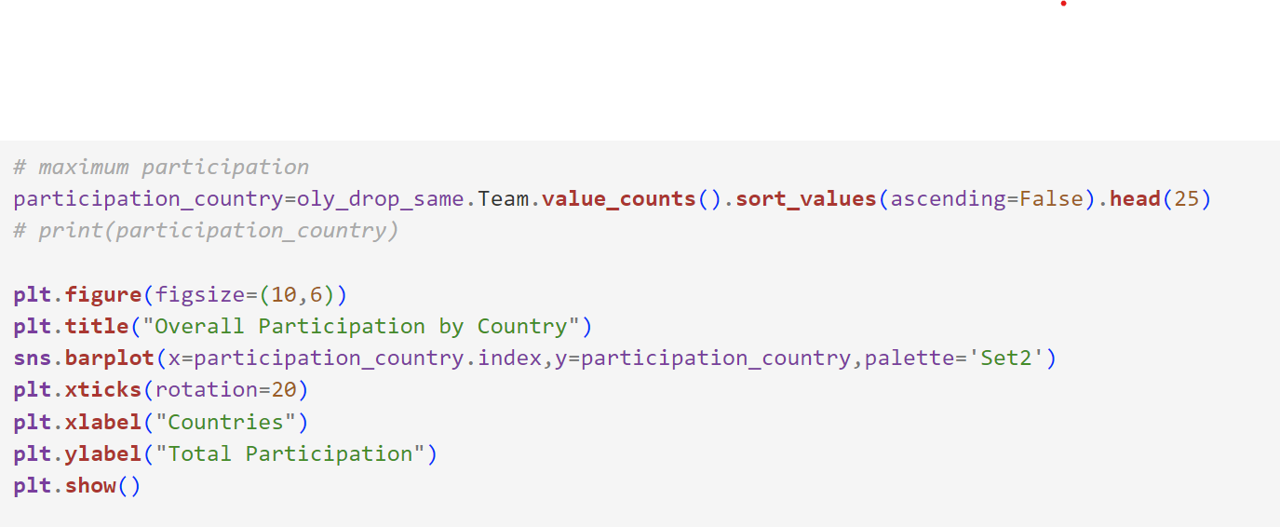
Plotting the graph

Slide 19
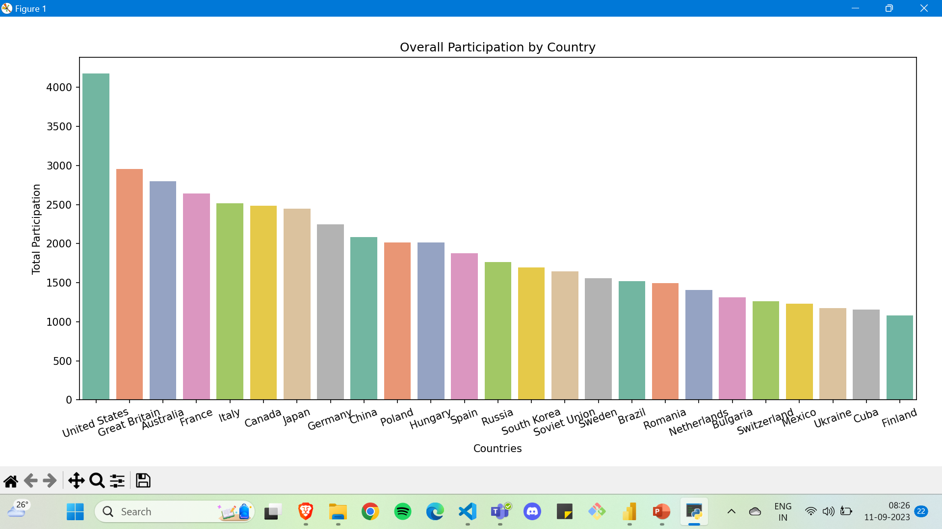

Slide 20
What can we conclude?
United States has exceptional participation in Olympics with a total of 4175 participation.
After US, all the next 24 Countries has participation approximately around 2000s

Slide 21
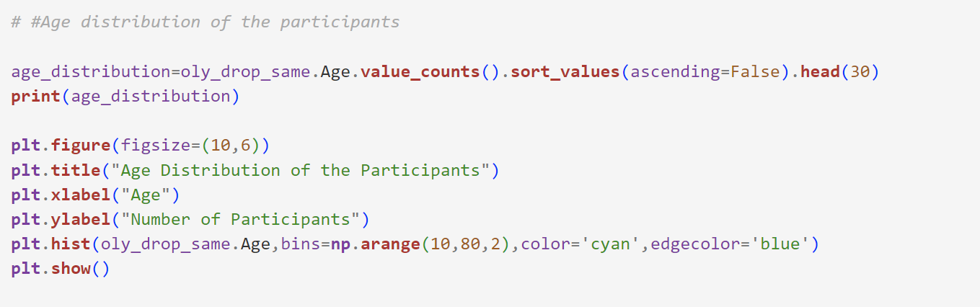
Age Distribution

Slide 22
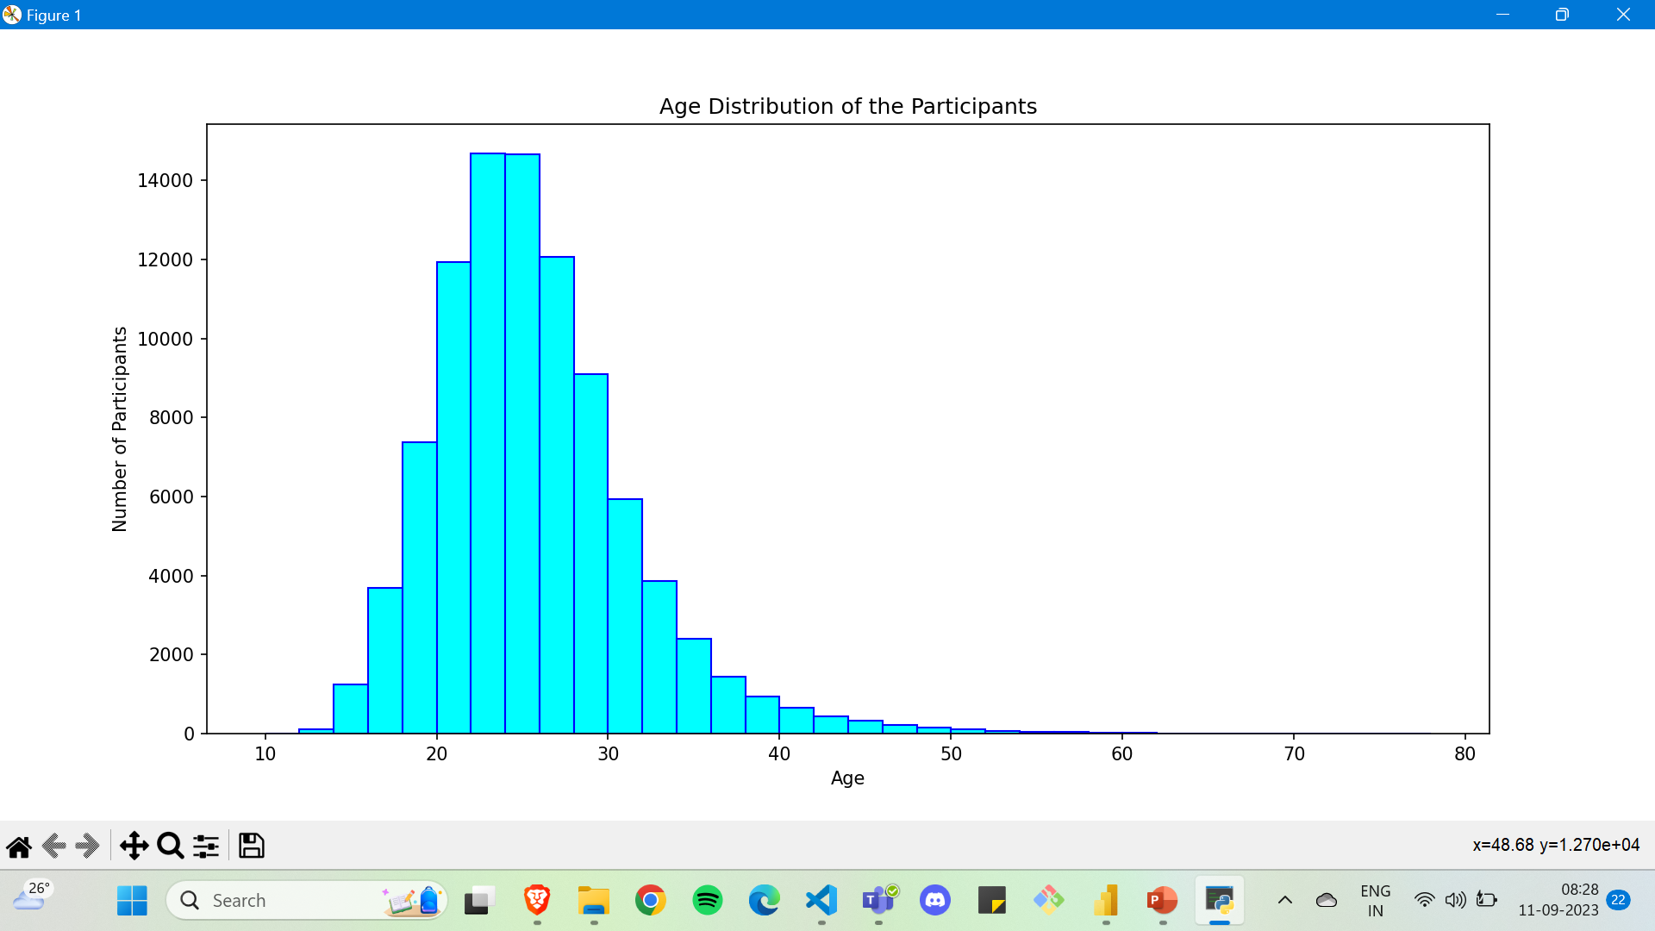
Graph of Age Distribution
We plotted a histogram graph.

Slide 23
What can we conclude?
The maximum participants are of Age 24 to Age 26.
There are few participants from age 40 above and less than 16.
The graph is more right skewed.
We can say the participants above 40 years and below 16 years can be treated as outliers.

Slide 24
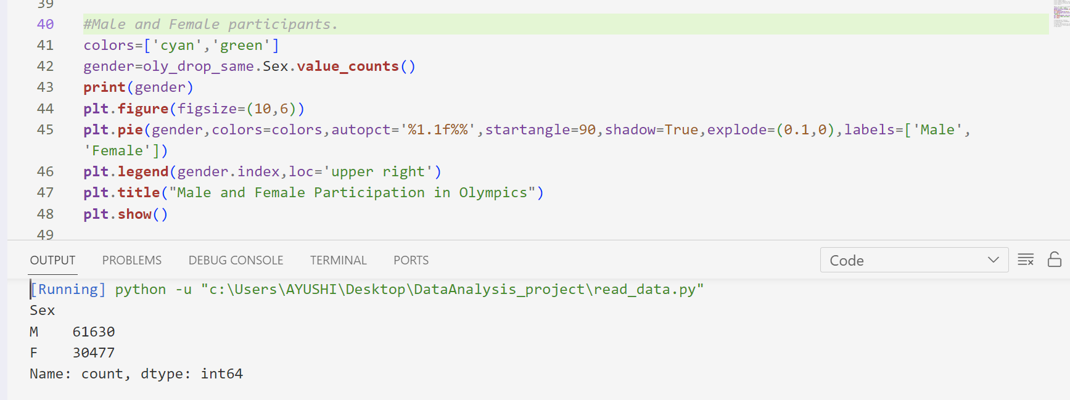
Male and female participation
CODE

Slide 25
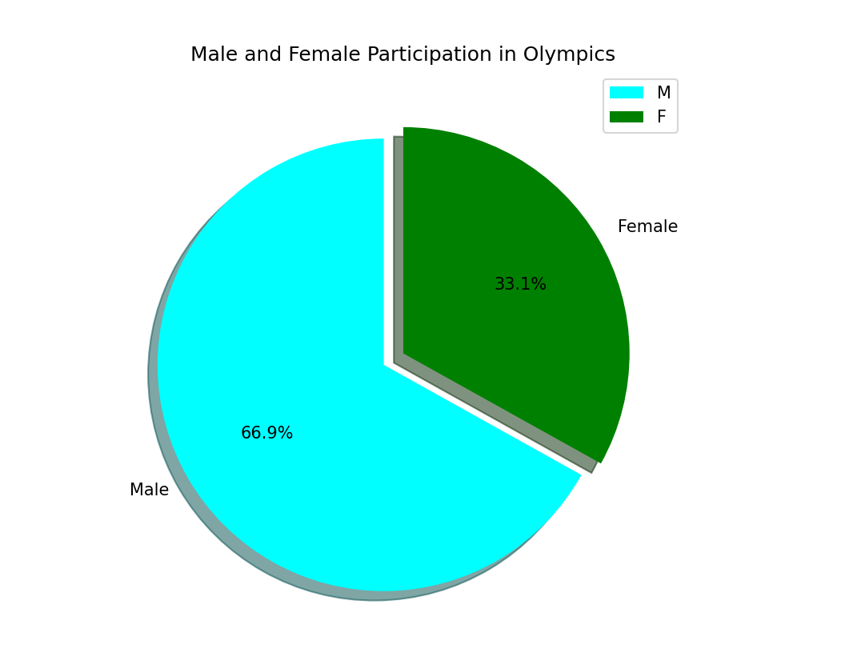
Graph of Male v/s Female Participation

Slide 26
What can we conclude?
Most participants are Male.
The female participants are approximately 1/3rd of total participants.

Slide 27
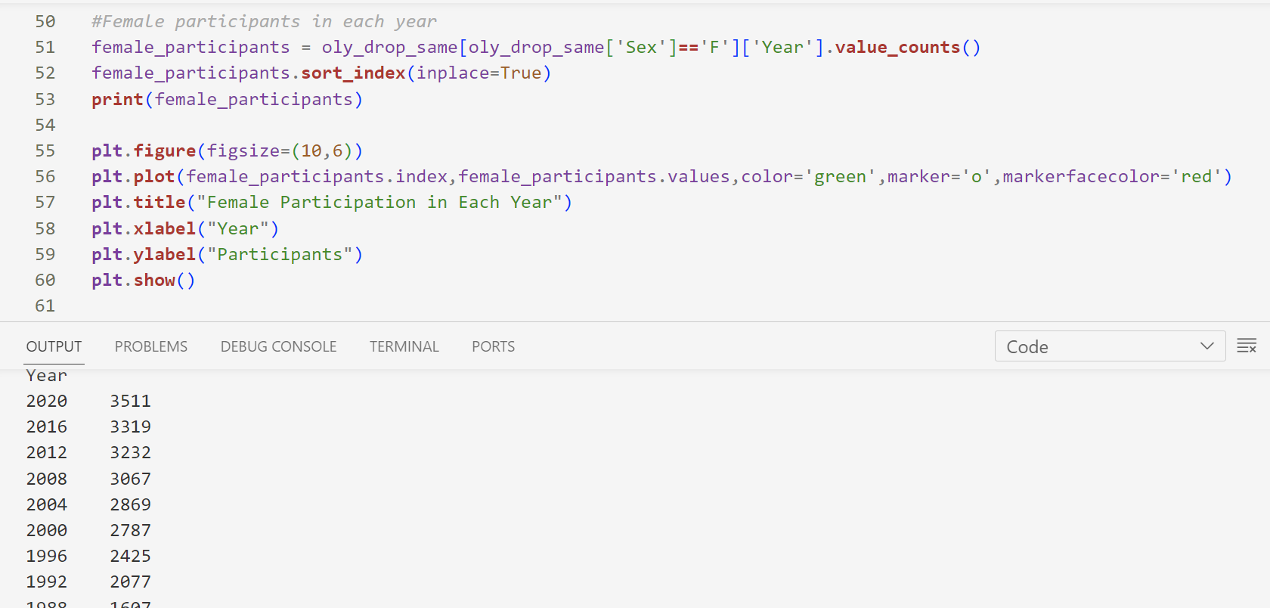
Female participation in Each Year

Slide 28
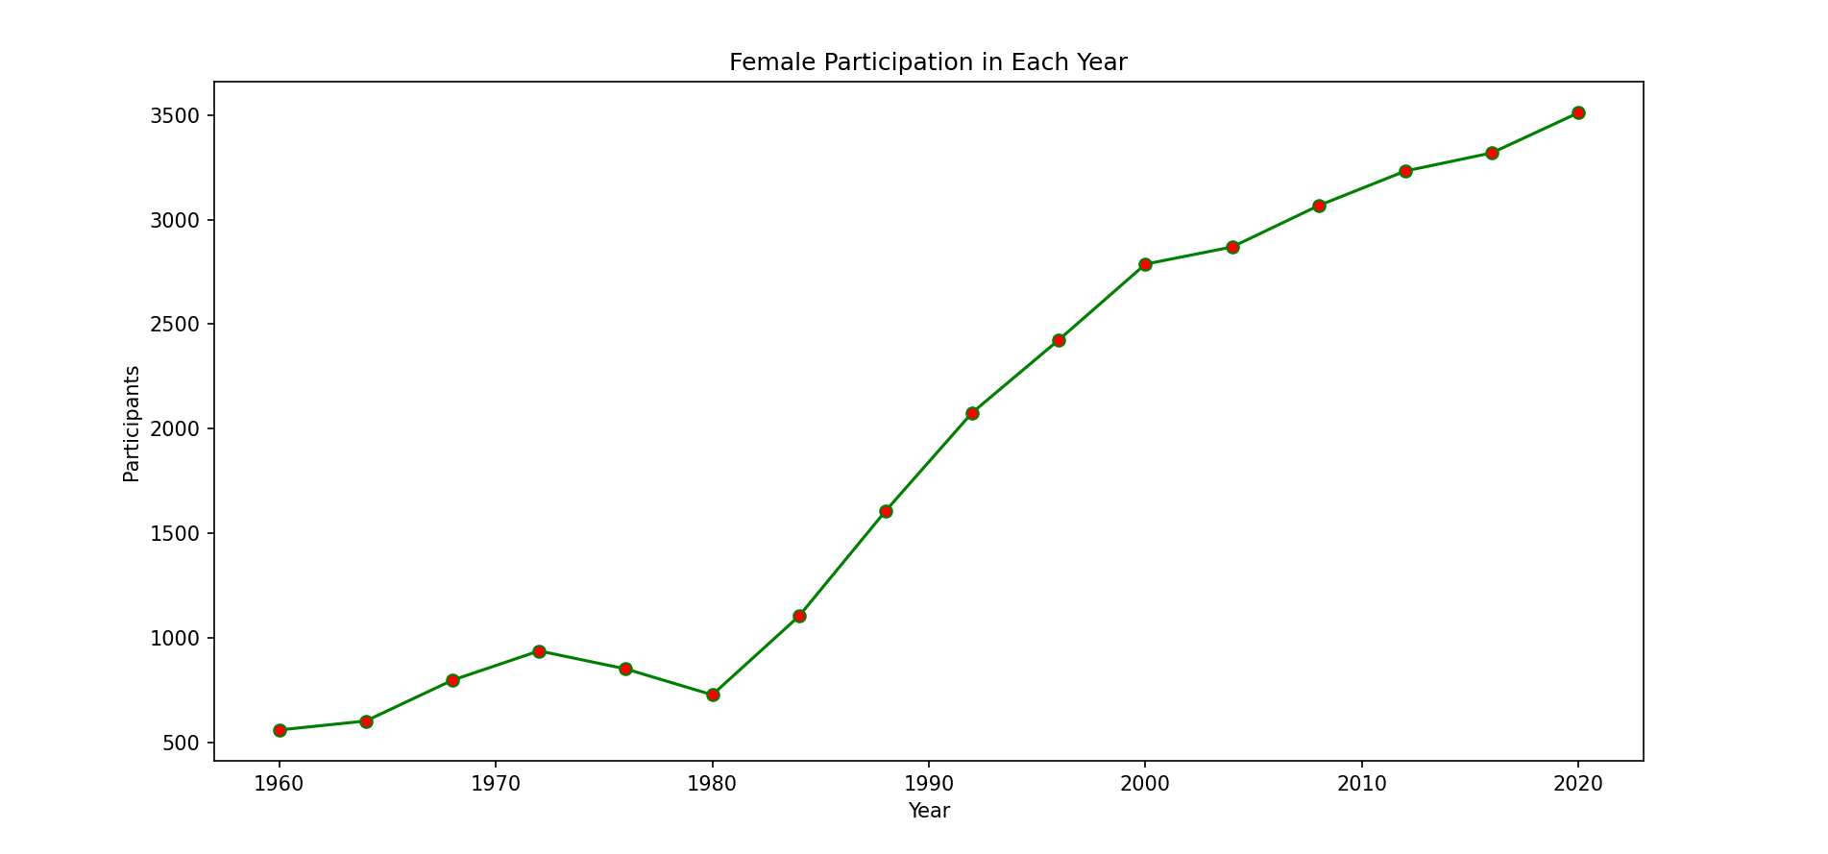
Plotting the Graph

Slide 29
What can we conclude?
The female participation in general has seen a rise.
After 1980s, there has been a great rise in participation.
Around 1972s, there was a slight decrease in participation till 1980. But after that it has increased.
We can conclude, the participation is increasing in general.

Slide 30
Week 3 Update

Slide 31
USING POWER BI

Slide 32
WHAT WE DID ?
WE HAVE MADE 8 VISUALISATION IN POWER BI INCLUDING
THE BAR GRAPH, LINE CHART, TREE MAP, Q/A AND MATRIX

Slide 33
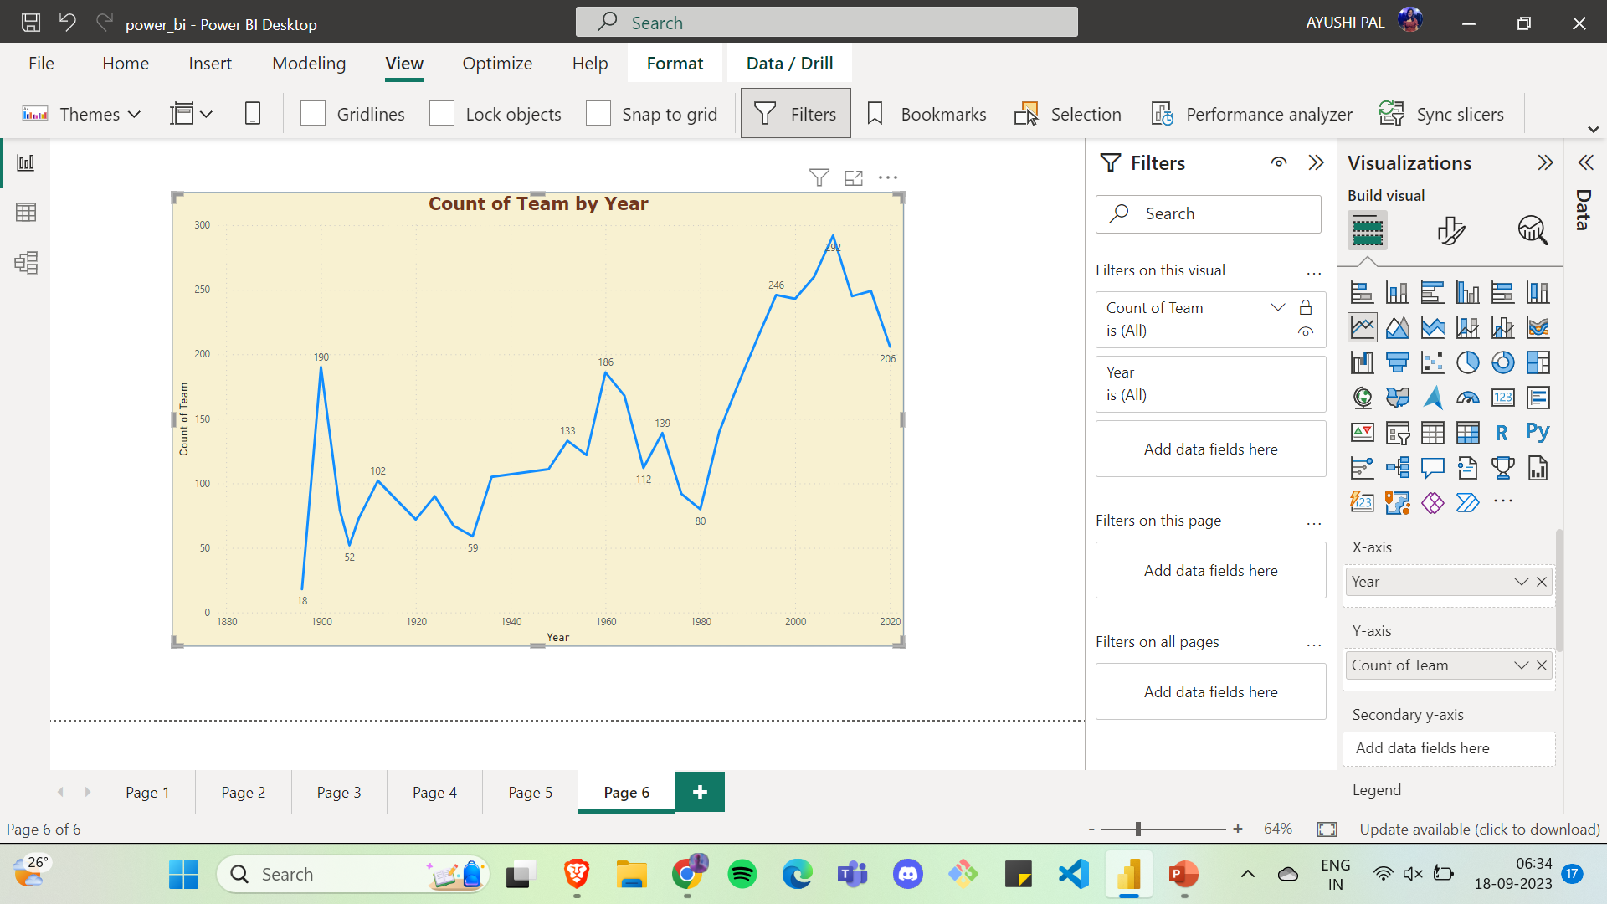
Count of Team by Year
We have put year values in X- axis and count of distinct team in Y-axis.

Slide 34
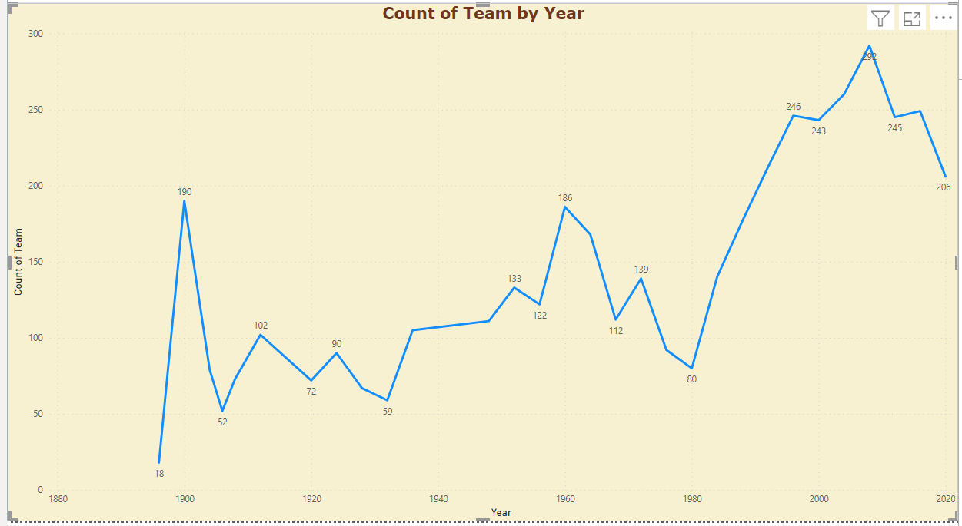
What can we conclude?
A maximum of 292 team have participated in the year 2012 and a minimum om of 18 teams in 1896

Slide 35
Majority Females who have won Olympic medal are of which age?
Our next visualisation is knowing the pattern of age distribution in females who have won any Olympic medal
We have plot bar graph with count of medal in y-axis and the age of females in x-axis.
For this we have applied the filter that Sex should be ‘F’ and medals should be ‘Gold’ ,’Silver’ and ‘Bronze’.

Slide 36
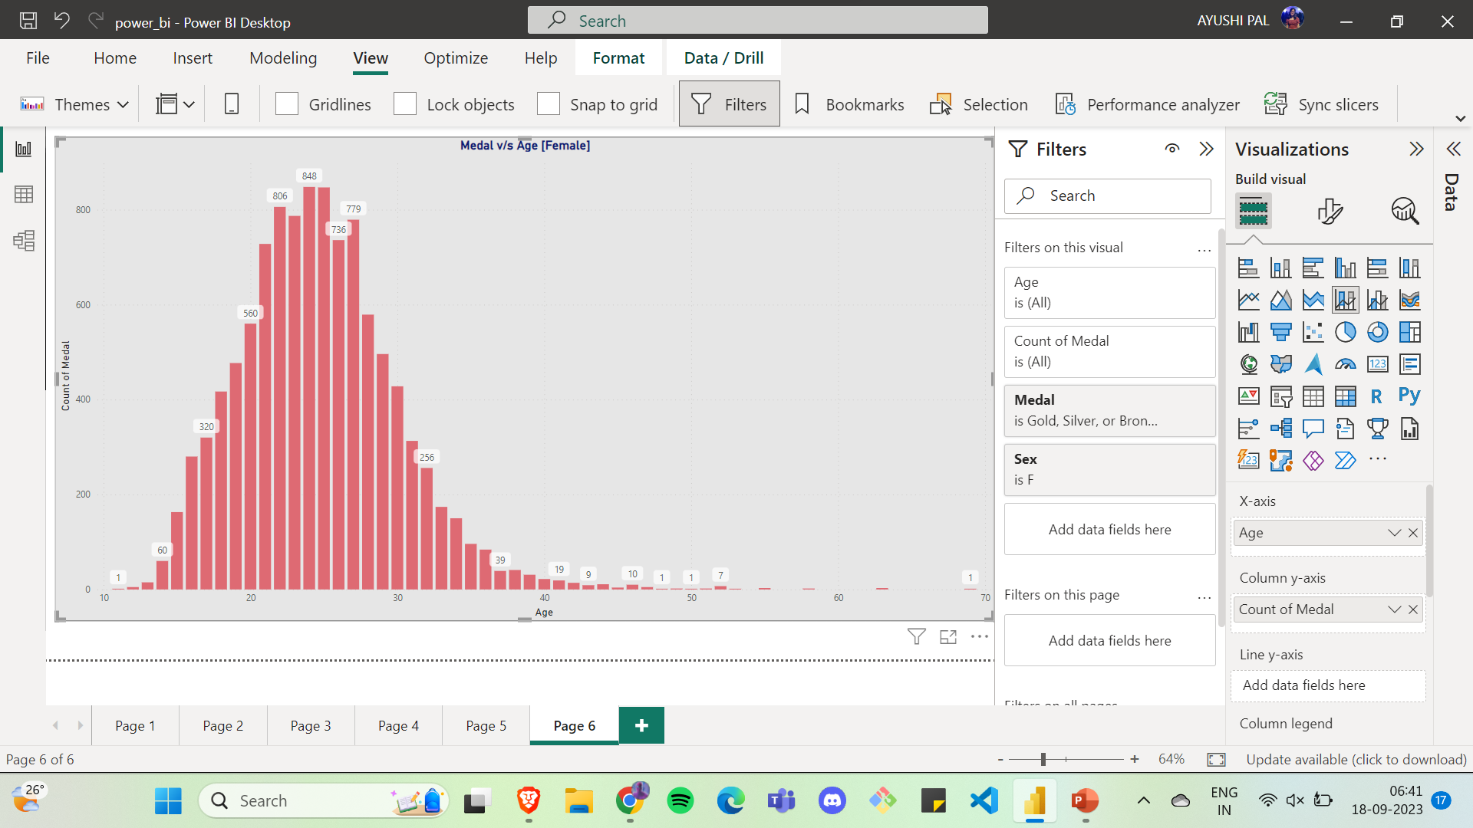

Slide 37
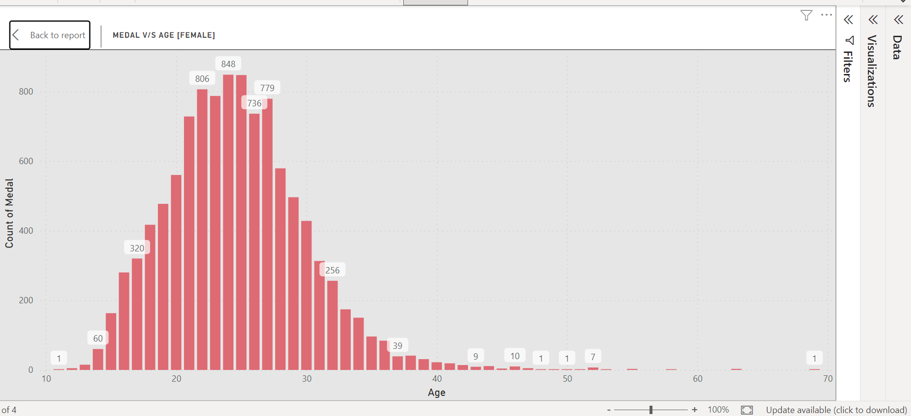
What can we conclude?
Majority of women who have won any medal are between age 20-30.
There are exceptionally few medals after age 40 and very few below age 15.

Slide 38
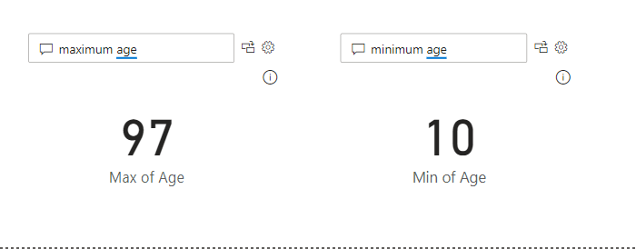
Minimum age participant and Maximum age participant
We used the Q/A Feature of Power BI where we write our input query, and it will show the output

Slide 39
India’s medal distribution
We used the pie chart to show how many gold , silver and bronze medal India have won.
We applied the filter that Team should be India and medal should not be Blank.

Slide 40
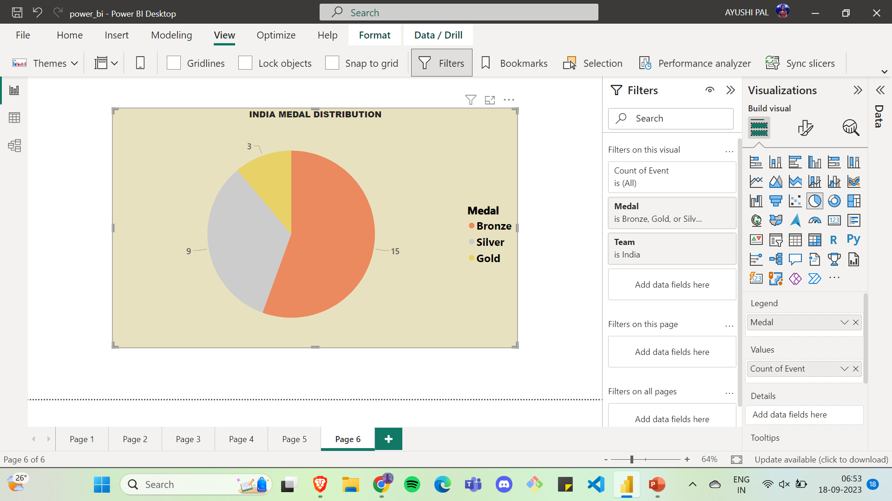

Slide 41
What can we conclude?
India have won 15 bronze medal, 9 silver medal and 3 gold medal

Slide 42
Indian Females who have Won medals
We again used the Q/A feature to retrieve our information about those woman who have won any medals in Olympic from India
For this we input our query as ‘Team = India’ , Sex= ‘Female’ and medal = ‘Gold’ ‘Silver’ ’Bronze’

Slide 43
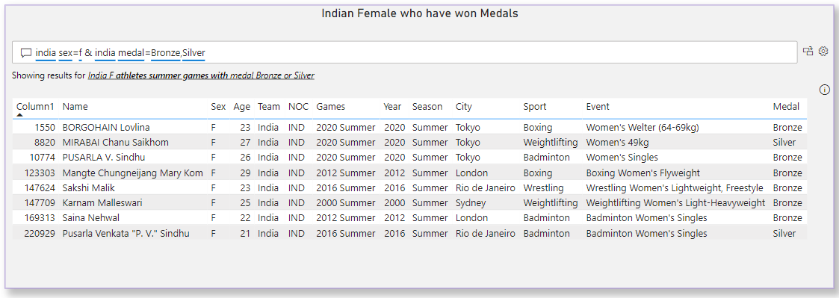

Slide 44
Top 10 Olympic Players of All Time
We used the bar plot to show top 10 players who have won Maximum medal and showing how many gold silver and bronze medal they have won.
We used the stacked bar plot for this visualisation.
We put count of medal as legends, name as x-axis and count of medal as y axis.
We applied filter on name to show top 10 athletes only.

Slide 45
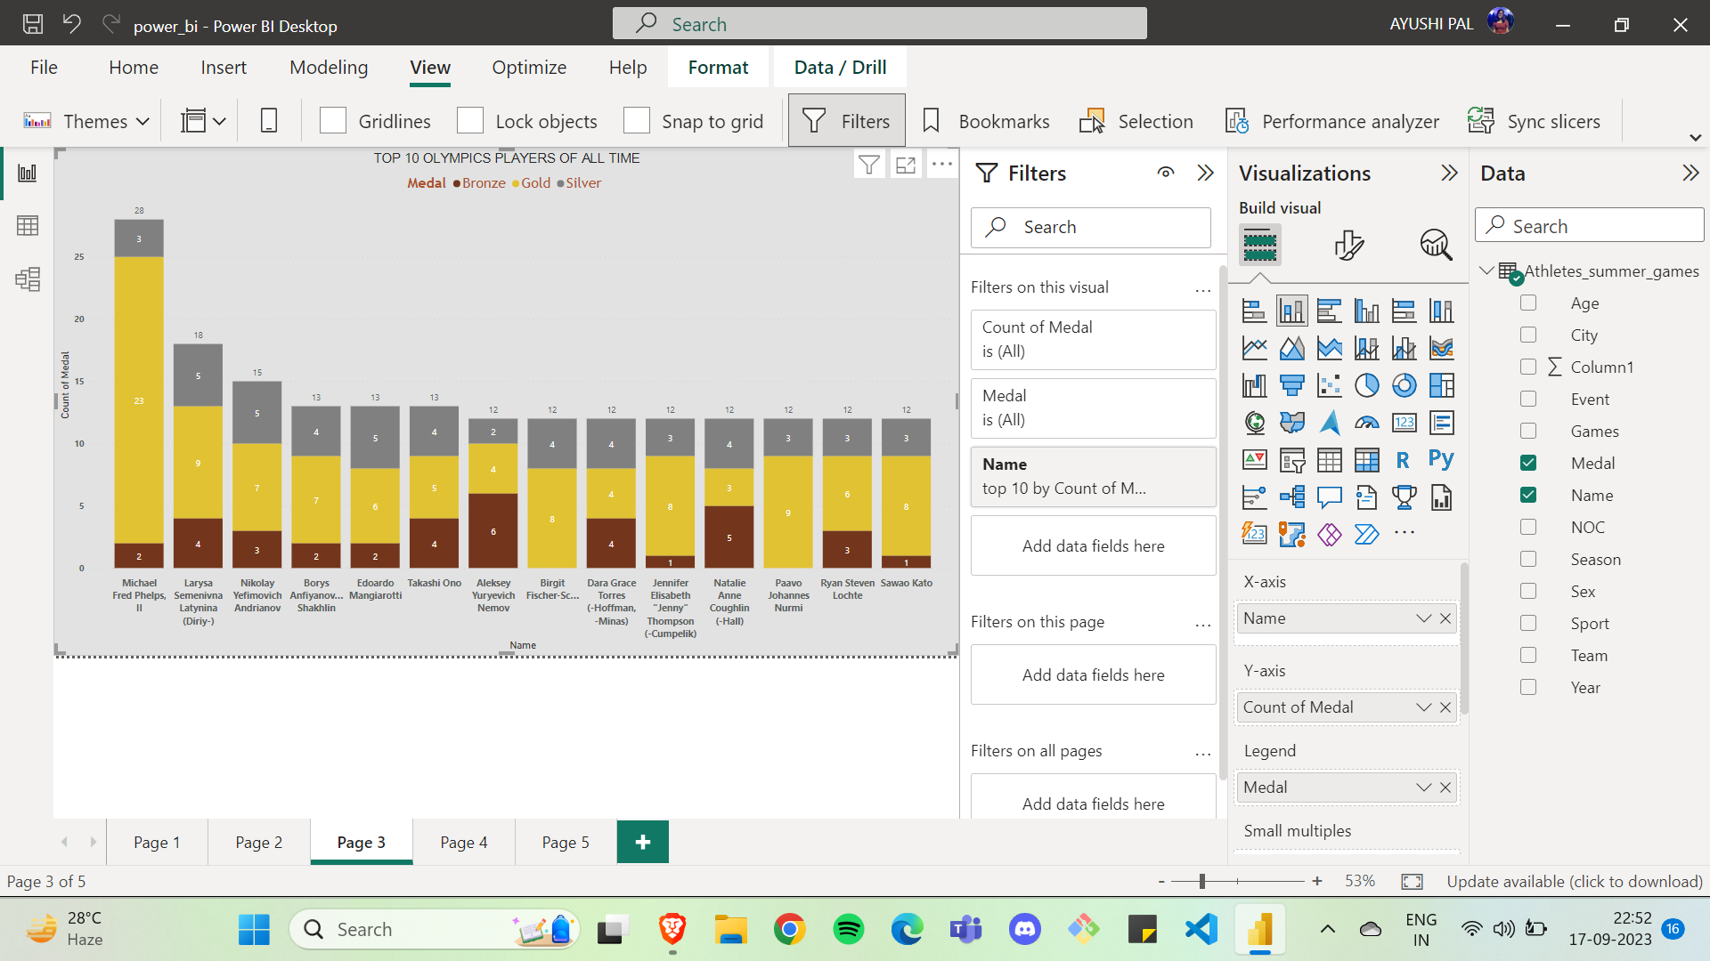

Slide 46
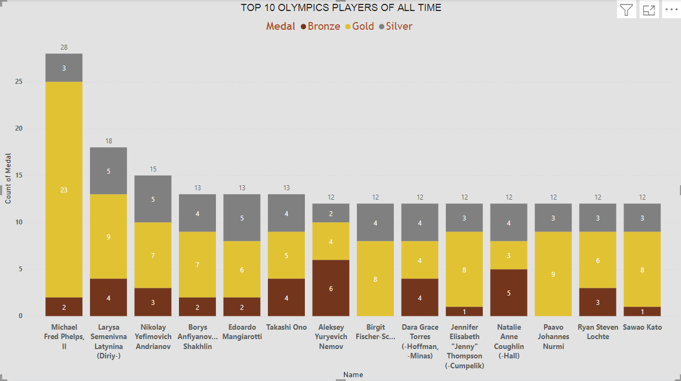
What can we conclude?
Michael Fred Phelps is the greatest player of all time with an exceptional medal count of 28 out of which 23 were gold.

Slide 47
Sports v/s Medals
Which sports counts for maximum medal?
We used the Tree map to show how much medals are won in each sports.

Slide 48
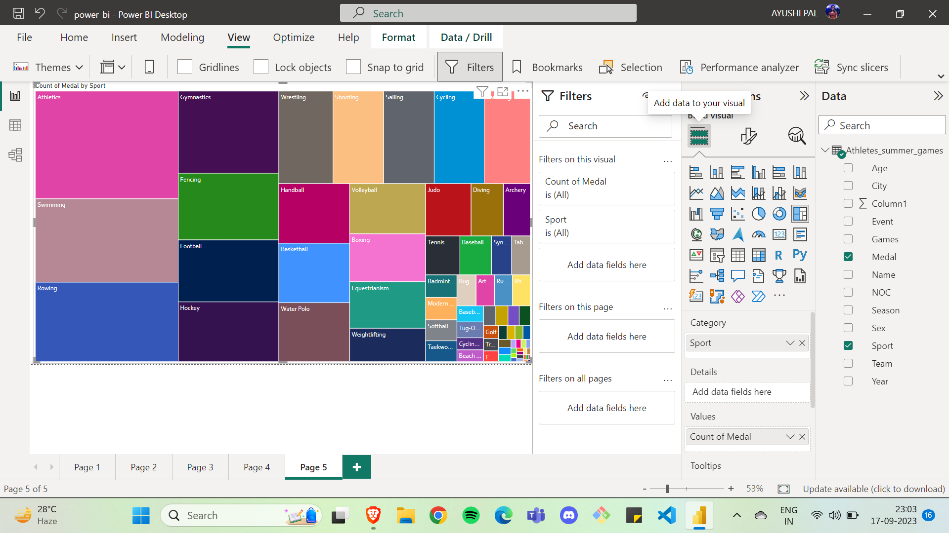

Slide 49
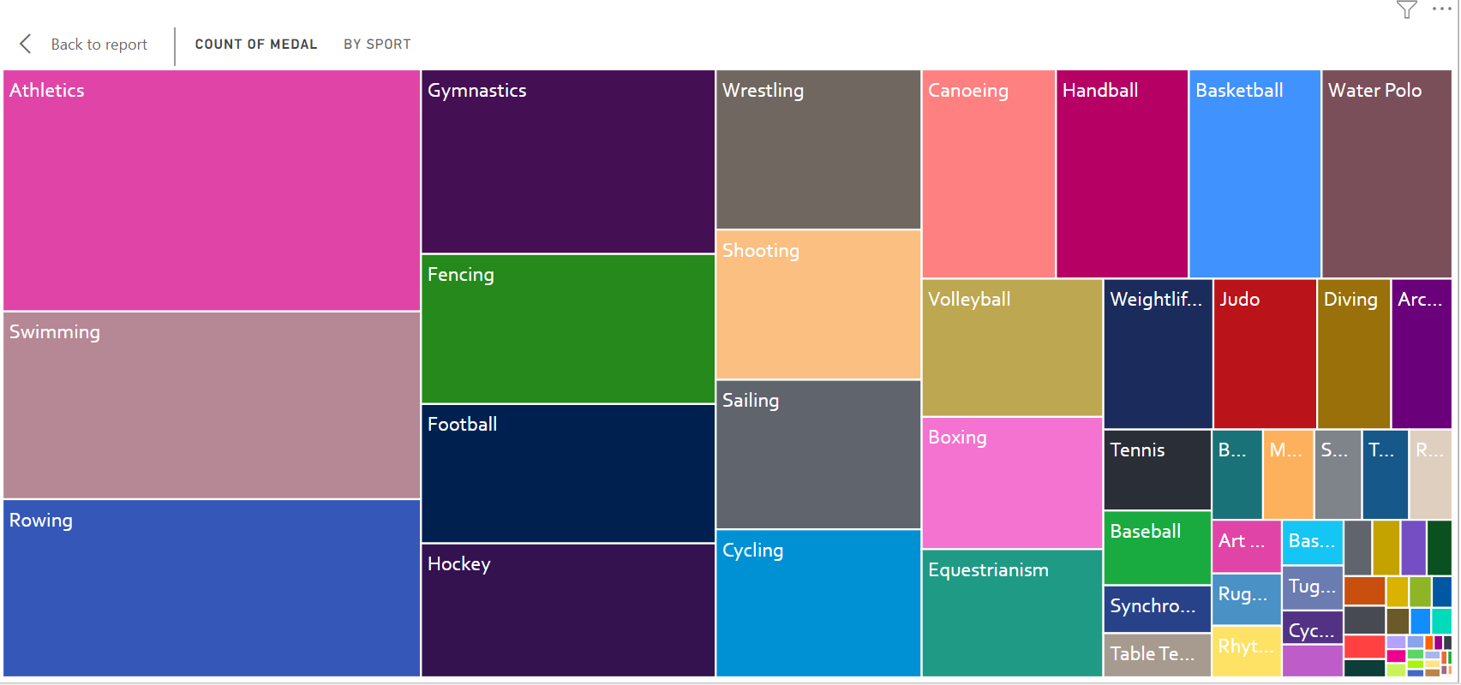
What can we conclude?
We can conclude that majority of medals are won in Athletics .

Slide 50
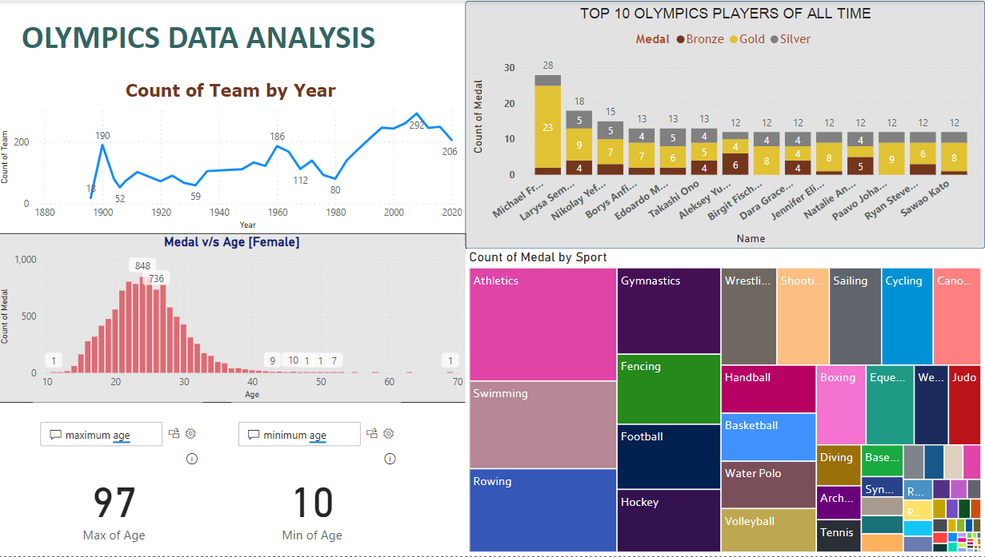

Slide 51
WEEK 4 UPDATE

Slide 52
What we did?
This week we analyse the performance of India at Olympics. We focused on visualising using Power BI

Slide 53
INDIA’S PARTICIPATION IN OLYPMICS
We created a Line graph to show the trend of India’s participation in the Olympics.
We kept the count of Participants in Y-Axis and Year in X-Axis and we filter the team as India

Slide 54
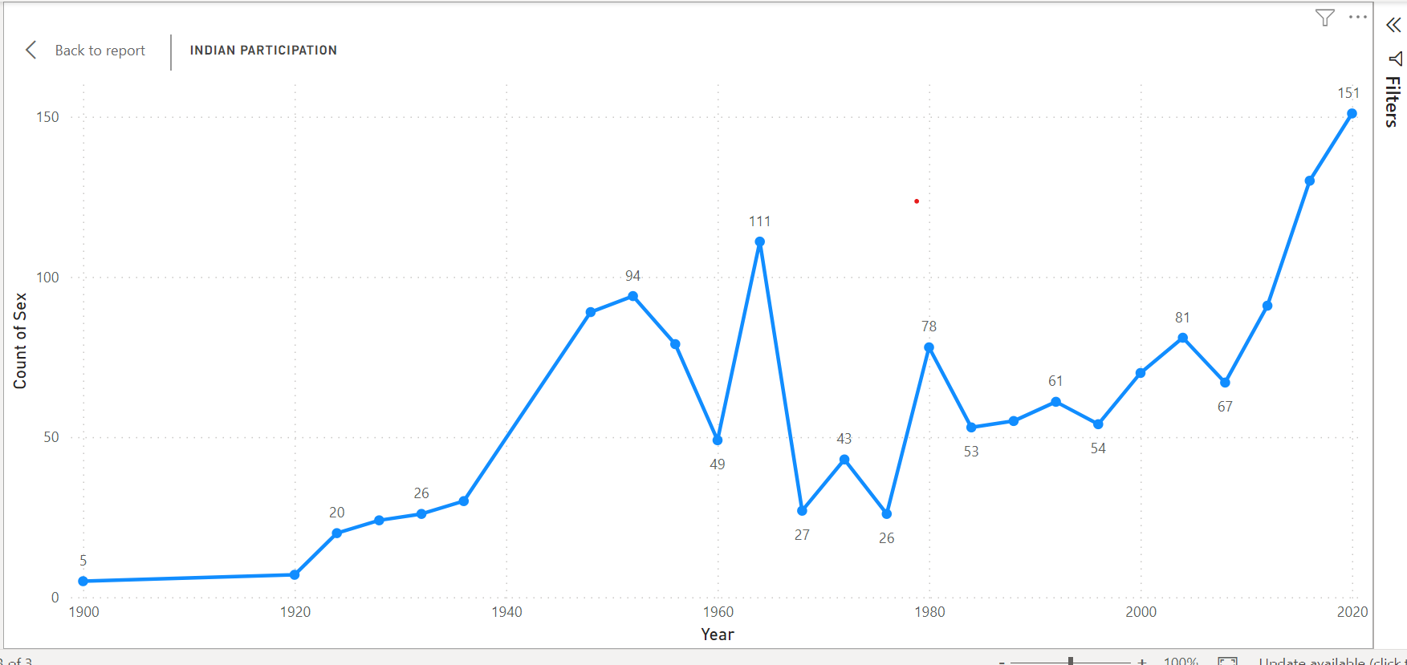

Slide 55
What can we Conclude?
We can see that overall, the participation of India is increasing.

Slide 56
Female Participation over the Year
We analysed the count of female participation over the year.
This again we did by plotting the line graph.

Slide 57
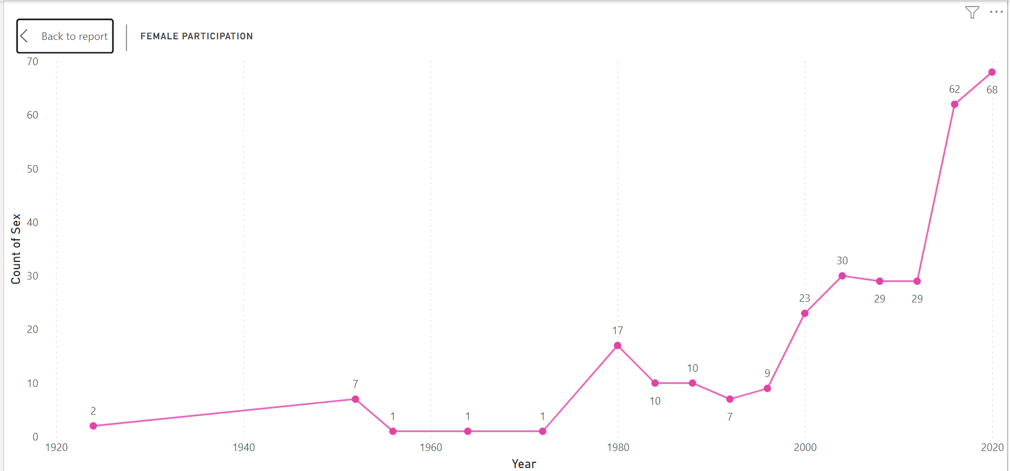

Slide 58
What can we conclude?
The female participation in general has seen a rise.
Around 2012s there has been a sharp rise from 29 to 62

Slide 59
Male v/s Female Participation
We plot a pie chart to show the relative count of participants by Sex

Slide 60
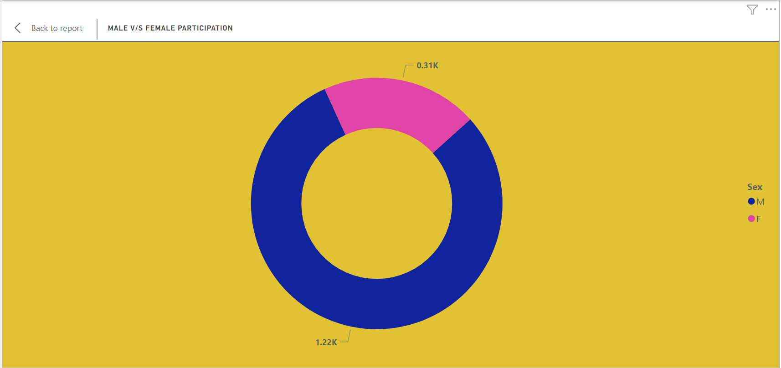

Slide 61
What can we Conclude?
Most participants are Male.
The female participants are approximately 1/3rd of total participants.

Slide 62
Top 10 Players from India
We used the bar plot to show top 10 players who have won Maximum medal and showing how many gold silver and bronze medal they have won.
We used the stacked bar plot for this visualisation.
We put count of medal as legends, name as x-axis and count of medal as y axis.

Slide 63
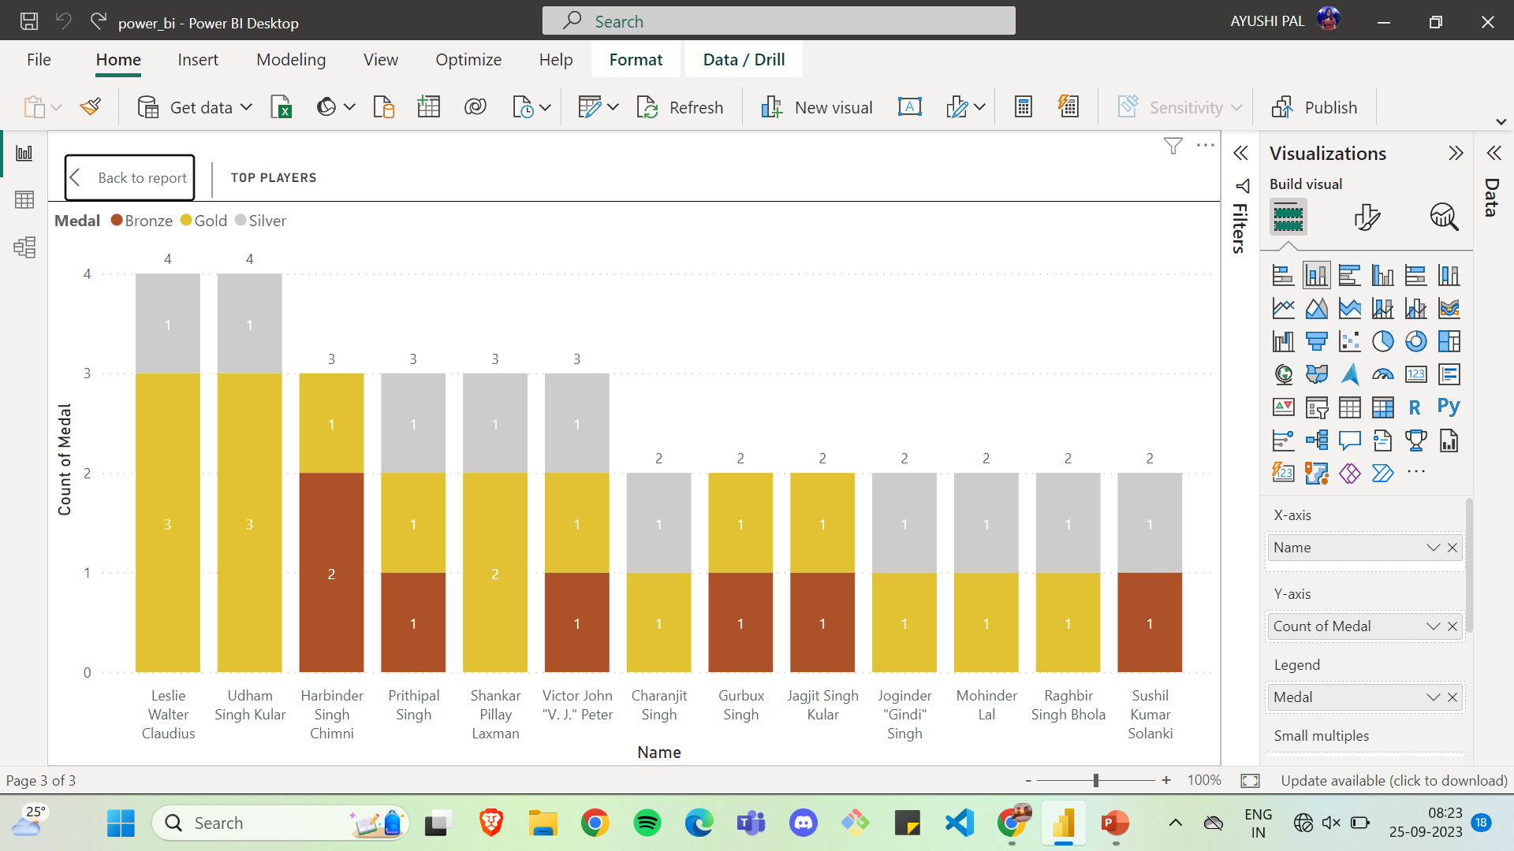

Slide 64
What can we conclude?
A max of 4 Olympics medal is in name of Udham Singh and Leslie Walter with 3 Gold and 1 Bronze.

Slide 65
Most medal by which sport?
Which sports counts for maximum medal?
We used the Tree map to show how much medals are won in each sports.

Slide 66
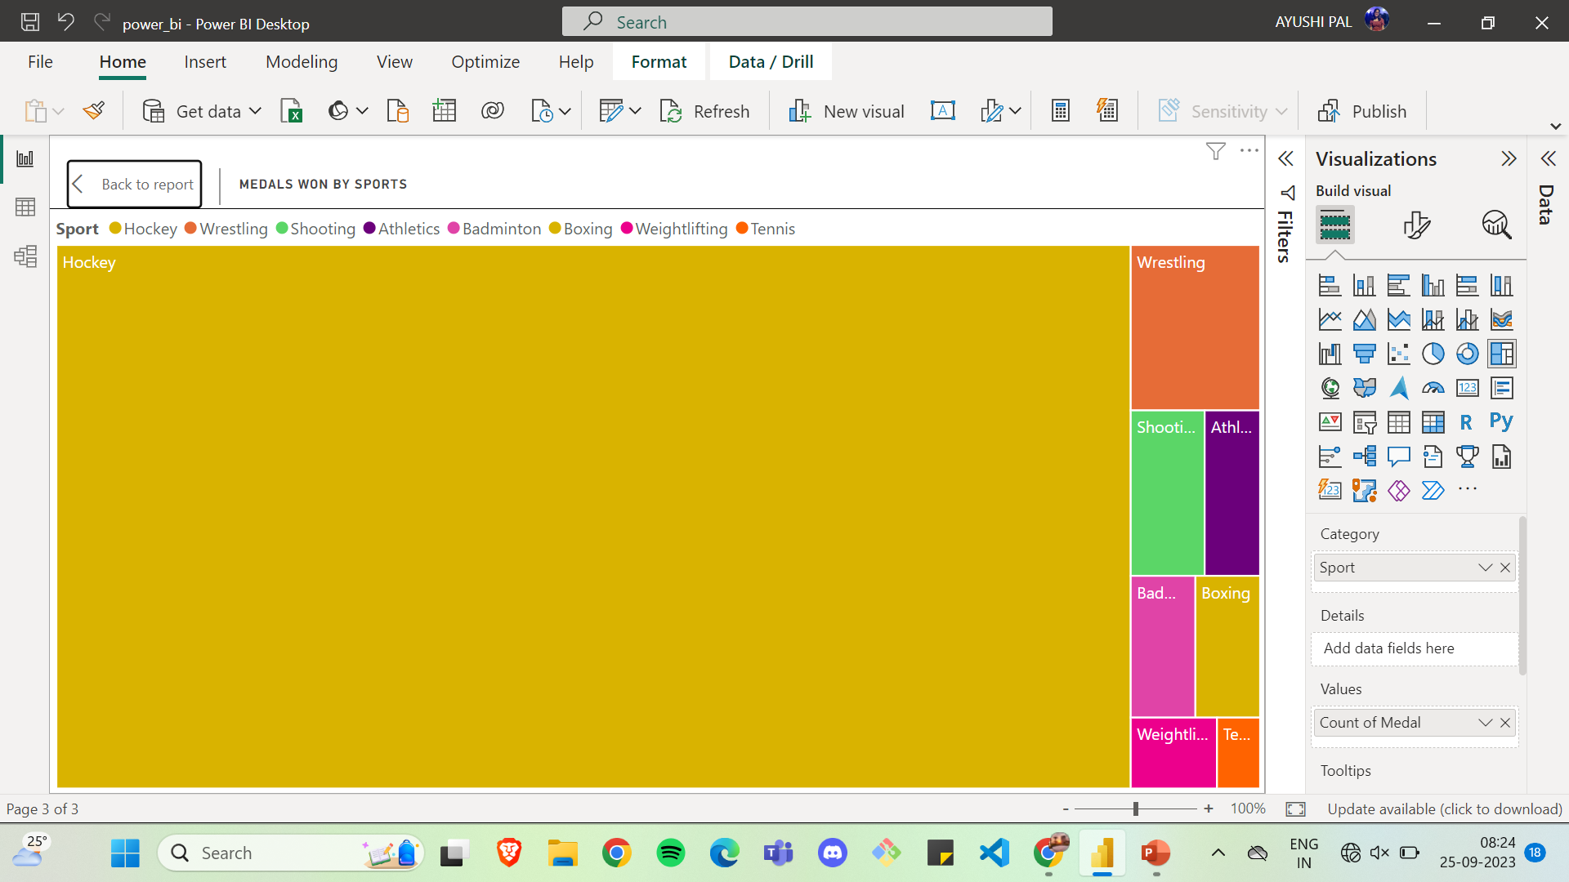

Slide 67
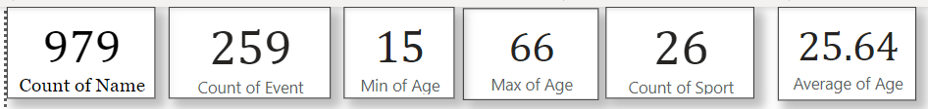
Extracting the information
We used the Q/A Feature of Power BI where we write our input query, and it will show the output

Slide 68
Final Report

Slide 69
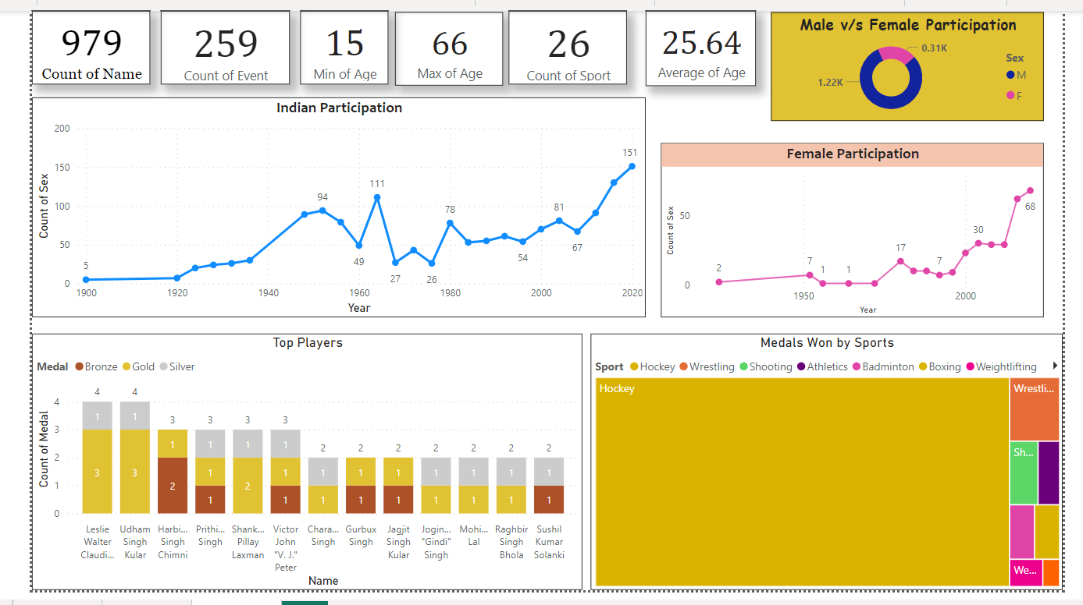

Slide 70

by-
AYUSHI PAL(22CD3008)
DEVANSH DUBEY(22CD3010)

Slide 71

THANK YOU

